Slide 1
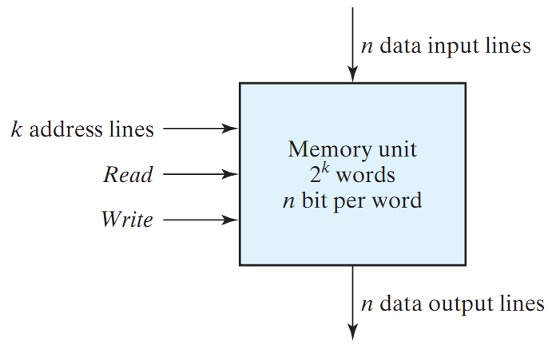
Memory
Memory: A collection of cells capable of storing binary information (1s or 0s) – in addition to electronic circuit for storing (writing) and retrieving (reading) information.
n data lines (input/output)
k address lines
2^{k} words (data unit)
Read/Write Control
Memory size = 2^{k} X n

Slide 2
Memory (cont.)
Two Types of Memory:
Random Access Memory (RAM):
Write/Read operations
Volatile: Data is lost when power is turned off
Read Only Memory (ROM):
Read operation (no write)
Non-Volatile: Data is permanent.
PROM is programmable (allow special write)

Slide 3
Read-Only Memory (ROM)
ROM: A device in which “permanent” binary information is stored using a special device (programmer)
k inputs (address) → 2^{k} words each of size n bits (data)
ROM DOES NOT have a write operation ➔ ROM DOES NOT have data inputs
k inputs
(address)
2^{k} x n ROM
n outputs
(data)
Word: group of bits stored in one location

Slide 4
Read-Only Memory (ROM)
A semi-conductor memory is a device where data can be stored and retrieved.
Logically, this memory device can be regarded as a table of memory cells (data).
0
1
2
3
:
:
:
:
k
1-word data
Addresses
:
:
1-bit data
word size

Slide 5
Example 1
Example: Design a combinational circuit using ROM (memory size). The circuit accepts a 3-bit number and generates an output binary number equal to the square of the number.
Solution: Derive truth table:
Inputs |  |  |  | Outputs
A2 | A1 | A0 |  | B5 | B4 | B3 | B2 | B1 | B0 | SQ
0 | 0 | 0 |  | 0 | 0 | 0 | 0 | 0 | 0 | 0
0 | 0 | 1 |  | 0 | 0 | 0 | 0 | 0 | 1 | 1
0 | 1 | 0 |  | 0 | 0 | 0 | 1 | 0 | 0 | 4
0 | 1 | 1 |  | 0 | 0 | 1 | 0 | 0 | 1 | 9
1 | 0 | 0 |  | 0 | 1 | 0 | 0 | 0 | 0 | 16
1 | 0 | 1 |  | 0 | 1 | 1 | 0 | 0 | 1 | 25
1 | 1 | 0 |  | 1 | 0 | 0 | 1 | 0 | 0 | 36
1 | 1 | 1 |  | 1 | 1 | 0 | 0 | 0 | 1 | 49

Slide 6
Example 1 (cont.)
Inputs |  |  |  | Outputs
A2 | A1 | A0 |  | B5 | B4 | B3 | B2 | B1 | B0 | SQ
0 | 0 | 0 |  | 0 | 0 | 0 | 0 | 0 | 0 | 0
0 | 0 | 1 |  | 0 | 0 | 0 | 0 | 0 | 1 | 1
0 | 1 | 0 |  | 0 | 0 | 0 | 1 | 0 | 0 | 4
0 | 1 | 1 |  | 0 | 0 | 1 | 0 | 0 | 1 | 9
1 | 0 | 0 |  | 0 | 1 | 0 | 0 | 0 | 0 | 16
1 | 0 | 1 |  | 0 | 1 | 1 | 0 | 0 | 1 | 25
1 | 1 | 0 |  | 1 | 0 | 0 | 1 | 0 | 0 | 36
1 | 1 | 1 |  | 1 | 1 | 0 | 0 | 0 | 1 | 49
ROM truth table – specifies the required connections
B₀
0
B₁
B1 is ALWAYS 0 ➔ no need to generate it using the ROM
B0 is equal to A0 ➔ no need to generate it using the ROM
Therefore: The minimum size of ROM needed is 2³X4 or 8X4
A₀
B₂
A₁
8 X 4 ROM
B₃
B₄
A₂
B₅

Slide 7
Example 2
Problem: Tabulate the truth for an 8 X 4 ROM that implements the following four Boolean functions:
A(X,Y,Z) = Σm(3,6,7); B(X,Y,Z) = Σm(0,1,4,5,6)
C(X,Y,Z) = Σm(2,3,4); D(X,Y,Z) = Σm(2,3,4,7)
Solution:
A
X
8 X 4 ROM
B
Y
Z
C
D
Inputs |  |  |  | Outputs
X | Y | Z |  | A | B | C | D
0 | 0 | 0 |  | 0 | 1 | 0 | 0
0 | 0 | 1 |  | 0 | 1 | 0 | 0
0 | 1 | 0 |  | 0 | 0 | 1 | 1
0 | 1 | 1 |  | 1 | 0 | 1 | 1
1 | 0 | 0 |  | 0 | 1 | 1 | 1
1 | 0 | 1 |  | 0 | 1 | 0 | 0
1 | 1 | 0 |  | 1 | 1 | 0 | 0
1 | 1 | 1 |  | 1 | 0 | 0 | 1

Slide 8
Types of ROMs
A ROM programmed in four different ways:
ROM: Mask Programming
By a semiconductor company
PROM (Programmable ROM)
User can connect fuses with a special programming device (PROM programmer)
Only programmed once
EPROM (Erasable PROM)
Can be erased using Ultraviolet Light
Electrically Erasable PROM (EEPROM or E²PROM)
Like an EPROM, but erased with electrical signal

Slide 9
Programmable Logic Devices
Fixed
AND array
Fuses
Fused
programmable
OR array
Inputs
Outputs
Programmable Read Only Memory (PROM)
Fuses
Fused
programmable
AND array
Fixed
OR array
Inputs
Outputs
Programmable Array Logic (PAL)
Fuses
Fused
programmable
AND array
Fuses
Fused
programmable
OR array
Inputs
Outputs
Programmable Logic Array (PLA)

Slide 10
Programmable Logic Array (PLA)
Combination of a programmable AND array followed by a programmable OR array.
Example: Design a PLA to realise the following three logic functions and show the internal connections.
f₁(A,B,C,D,E) = A'.B'.D' + B'.C.D' + A'.B.C.D.E'
f₂(A,B,C,D,E) = A'.B.E + B'.C.D'.E
f₃(A,B,C,D,E) = A'.B'.D' + B'.C'.D'.E + A'.B.C.D

Slide 11
Realising Logic Functions with PLAs
f₁(A,B,C,D,E) = A'.B'.D' + B'.C.D' + A'.B.C.D.E'
f₂(A,B,C,D,E) = A'.B.E + B'.C.D'.E
f₃(A,B,C,D,E) = A'.B'.D' + B'.C'.D'.E + A'.B.C.D
A
X
X
X
X
B
X
X
X
X
X
X
X
C
X
X
X
X
Programmable AND array
X
D
X
X
X
X
X
X
E
X
X
X
X
A'.B'.D'
B'.C.D'
A'.B.C.D.E'
Programmable OR array
X
X
X
f₁
f₂
f₃
X
X
X
X
X
P₁
P₂
P₃
P₄
P₅
P₆
P₇
A'B'D'
A'BCDE'
B'CD'E
A'BCD
B'CD'
A'BE
B'C'D'E

Slide 12
Arithmetic Logic Unit
An arithmetic-logic unit, or ALU, performs many different arithmetic and logic operations. The ALU is the “heart” of a processor—you could say that everything else in the CPU is there to support the ALU.
Here’s the plan:
We’ll show an arithmetic unit first, by building off ideas from the adder - subtractor circuit.
Then we’ll talk about logic operations a bit, and build a logic unit.
Finally, we put these pieces together using multiplexers.
We use some examples from the textbook, but things are re-labeled and treated a little differently.

Slide 13
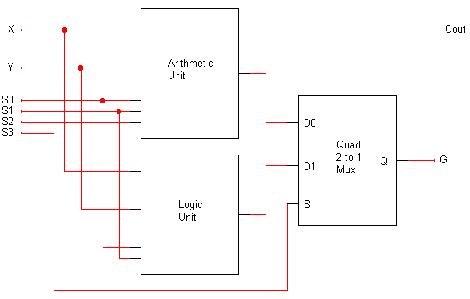
A complete ALU circuit
4
4
4
4
4

Slide 14
What does HDL stand for?
HDL is short for Hardware Description Language
VHDL – VHSIC (Very High Speed Integrated Circuit) Hardware Description Language

Slide 15
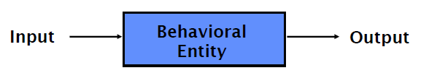
Basic Form of VHDL Code
Every VHDL design description consists of at least one entity / architecture pair, or one entity with multiple architectures.
The entity section is used to declare I/O ports of the circuit. The architecture portion describes the circuit’s behavior.
A behavioral model is similar to a “black box”.
Standardized design libraries are included before entity declaration.

Slide 16
Standard Libraries
Include library ieee; before entity declaration.
ieee.std_logic_1164 defines a standard for designers to use in describing interconnection data types used in VHDL modeling.
ieee.std_logic_arith provides a set of arithmetic, conversion, comparison functions for signed, unsigned, std_ulogic, std_logic, std_logic_vector.
ieee.std_logic_unsigned provides a set of unsigned arithmetic, conversion, and comparison functions for std_logic_vector.

Slide 17
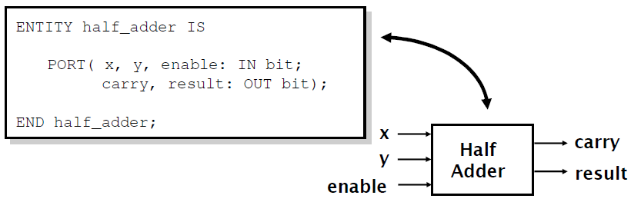
Entity Declaration
An entity declaration describes the interface of the component. Avoid using Altera’s primitive names
PORT clause indicates input and output ports.
An entity can be thought of as a symbol for a component.

Slide 18
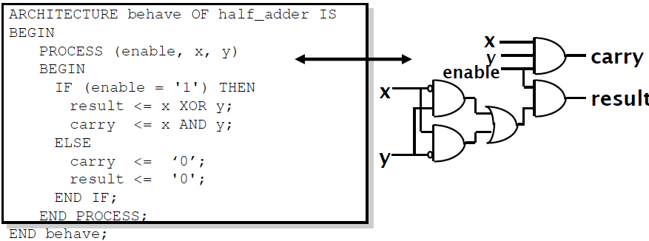
Architecture Declaration
Architecture declarations describe the operation of the component.
Many architectures may exist for one entity, but only one may be active at a time.
An architecture is similar to a schematic of the component.

Slide 19
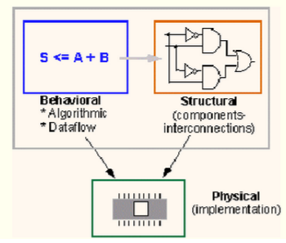
Modeling Styles
There are three modeling styles:
Behavioral (Sequential)
Data flow
Structural

Slide 20
Styles in VHDL
Behavioral
High level, algorithmic, sequential execution
Hard to synthesize well
Easy to write and understand (like high-level language code)
Dataflow
Medium level, register-to-register transfers, concurrent execution
Easy to synthesize well
Harder to write and understand (like assembly code)
Structural
Low level, netlist, component instantiations and wiring
Trivial to synthesize
Hardest to write and understand (very detailed and low level)

Slide 21
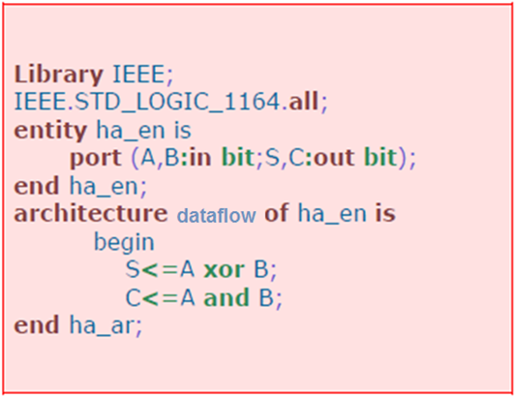
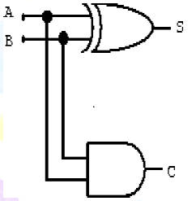
Dataflow modeling
The internal working of an entity can be implemented using concurrent signal assignment.
Half adder example

Slide 22
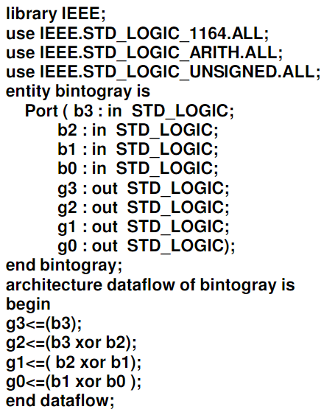
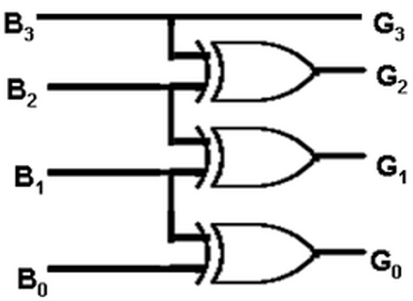
DATAFLOW MODELLING
BINARY TO GRAY CODE CONVERTOR

Slide 23
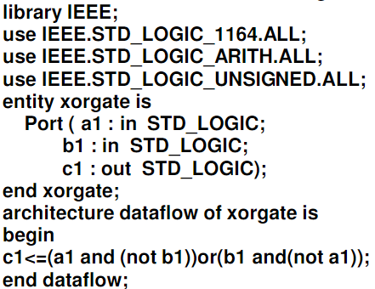
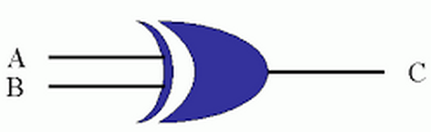
xor gate

Slide 24

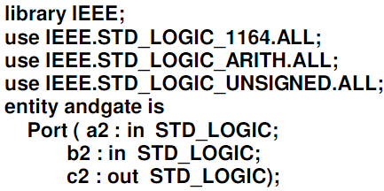
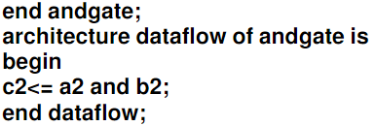
AND gate

Slide 25

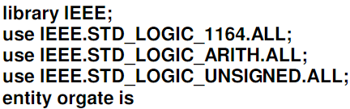
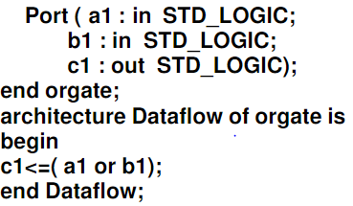
OR gate

Slide 26

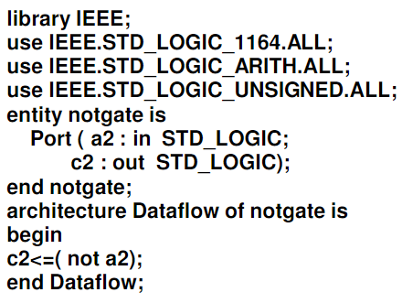
NOT gate

Slide 27
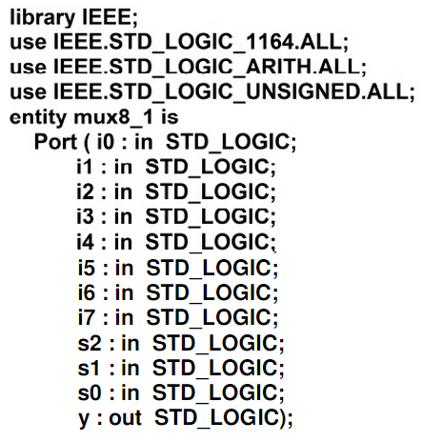
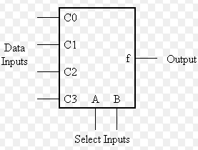
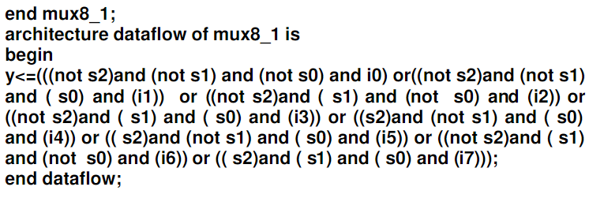
Multiplexer (8*1 MUX)

Slide 28
Behavioural modeling
The internal working of an entity can be implemented using set of statements. It contains:
Process statements
Sequential statements
Signal assignment statements
Wait statements

Slide 29
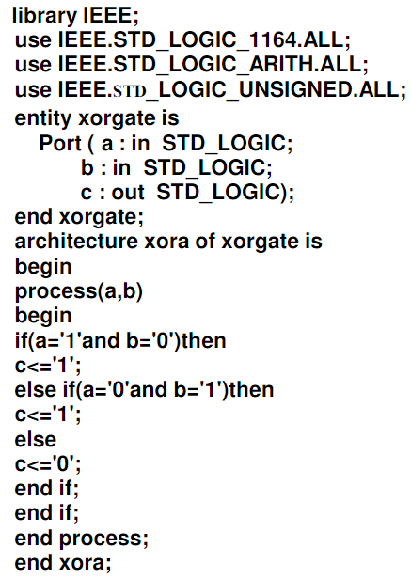
BEHAVIORAL MODELLING
XOR GATE

Slide 30
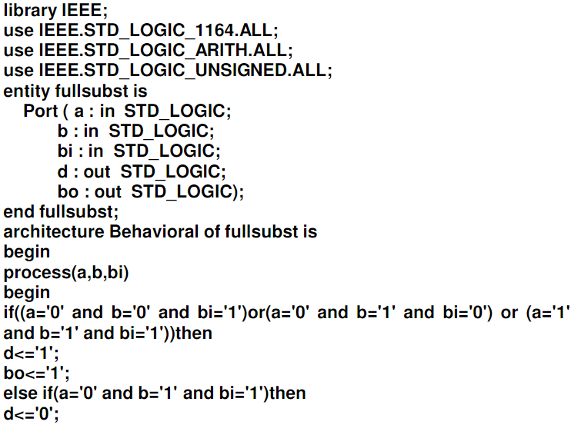
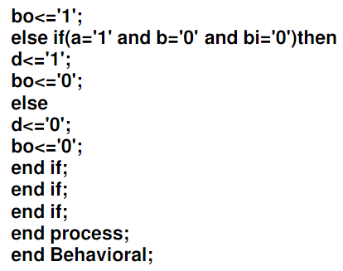
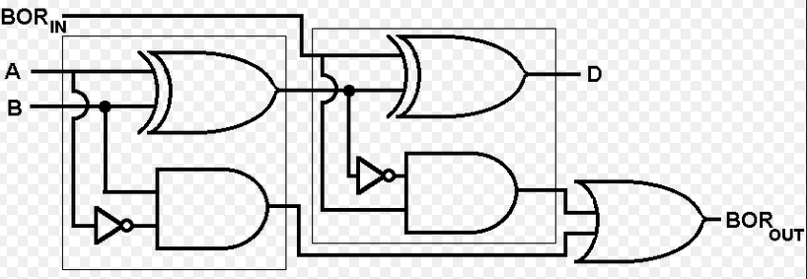
FULL SUBSTRACTOR

Slide 31
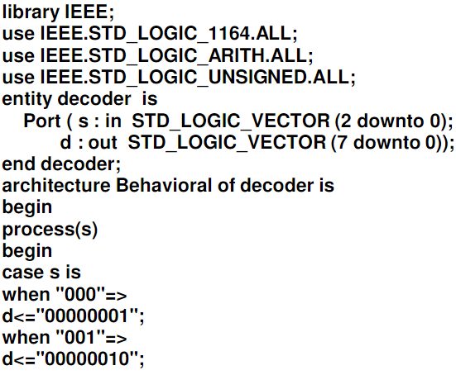
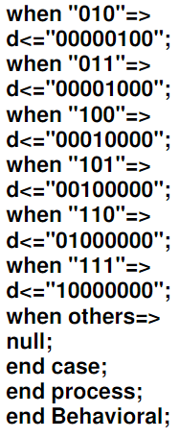
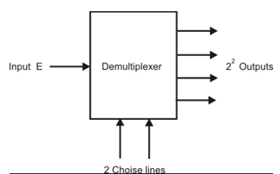
DEMULTIPLEXER

Slide 32
Structural modeling
The implementation of an entity is done through set of interconnected components. It contains:
Signal declaration.
Component instances
Port maps.
Wait statements.
Component declaration:
Before instantiating the component it should be declared Using component declaration as shown above. Component Declaration declares the name of the entity and interface of a component.
Syntax: Component component_name [is] List_of_interface ports; End component component_name;

Slide 33
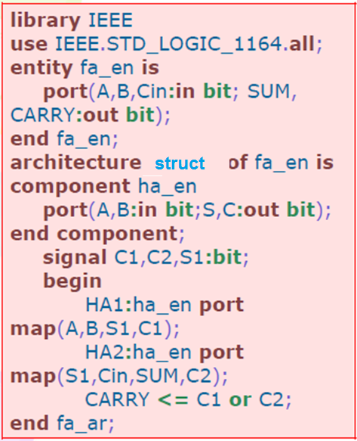
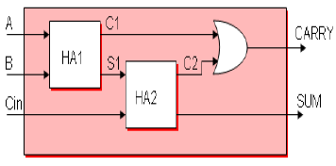
Full adder example

Slide 34
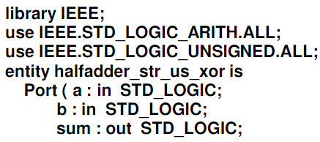

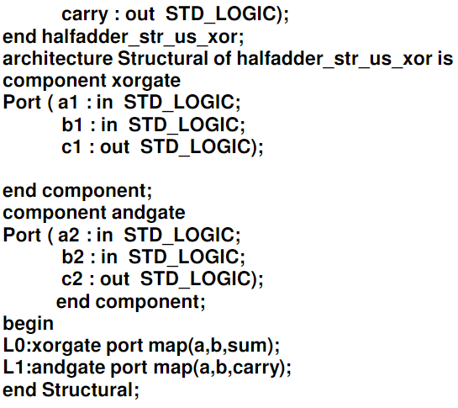
Half adder

